Slide 1
Real time Visual Recognition in Deep Convolutional Neural Networks
BATCH C12
TEAM MEMBERS: GUIDED BY
SREE SATHYA SHREYA T (211417104267) Mrs. SANGEETHA KRISHNAN
VAISHNAVI KARISHMA NAIDU (211417104287) Assistant Professor
VARSHAA PARAMESSH (211417104293) Department of CSE
Panimalar Engineering College
Chennai

Slide 2
ABSTRACT
Detecting the objects from images and videos has always been the point of active research area for the applications of computer vision and artificial intelligence namely robotics, self-driving cars, automated video surveillance, crowd management, home automation and manufacturing industries, activity recognition systems, medical imaging, and biometrics.
The recent years witnessed the boom of deep learning technology for its effective performance on image classification.
Convolutional neural networks have provided promising results for object detection by alleviating the need for human expertise for manually handcrafting the features for extraction.
It allows the model to learn automatically by letting the neural network to be trained on large-scale image data using powerful and robust GPUs in a parallel way, thus, reducing training time.
This paper aims to highlight the state-of-the-art approaches based on the convolutional neural networks especially designed for object detection from images.

Slide 3
LITERATURE SURVEY
S.NO | AUTHOR | TITLE | PROBLEM STATEMENT | RESULT
1 | Joseph Redmon, Santosh Divvala, Ross Girshick, Ali Farhadi | You Only Look Once: Unified, Real-Time Object Detection (2015) | A fast and simple approach to detecting real time images was introduced in this paper as You Only Look Once. The model was built to detect images accurately, fast and to differentiate between art and real images. | In comparison with Object detection techniques that came before YOLO, like R-CNN, YOLO introduced a single unified architecture for regression go image into bounding boxes and finding class probabilities for each box. This meant that YOLO performed much faster and also provided more accuracy. It could also predict artwork correctly.

Slide 4
S.NO | AUTHOR | TITLE | PROBLEM STATEMENT | RESULT
2 | Chengji Liu, Yufan Tao, Jiawei Liang, Kai Li, Yihang Chen | Object Detection Based on YOLO Network (2018) | A generalized object detection network was developed by applying complex degradation processes on training sets like noise, blurring, rotating and cropping of images. The model was trained with the degraded training sets which resulted in better generalizing ability and higher robustness. | The experiment showed that the model trained with the standard sets does not have good generalization ability for the degraded images and has poor robustness. Then the model was trained using degraded images which resulted in improved average precision. It was proved that the average precision for degraded images was better in general degenerative model compared to the standard model.

Slide 5
S.NO | AUTHOR | TITLE | PROBLEM STATEMENT | RESULT
3 | Wenbo Lan, Jianwu Dang, Yangping Wang, Song Wang | Pedestrian Detection Based on YOLO Network Model (2018) | The network structure of YOLO algorithm is improved and a new network structure YOLO-R was proposed to increase the ability of the network to extract the information of the shallow pedestrian features by adding pass through layers to the original YOLO network. | The YOLO v2 and YOLO-R network models were tested on the test set of the INRIA data set. The experimental results show that the YOLO-R network model is superior to the original YOLO v2 network model. The number of detection frames reached 25 frames/s, basically meeting the requirement of real time performance.

Slide 6
S.NO | AUTHOR | TITLE | PROBLEM STATEMENT | RESULT
4 | Rumin Zhang, Yifeng Yang | An Algorithm for Obstacle Detection based on YOLO and Light Filed Camera (2018) | An obstacle detection algorithm in the indoor environment is proposed which combines the YOLO object detection algorithm and the light field camera and will classify objects into categories and mark them in the image. | The images of the common obstacles were labeled and used for training YOLO. The object filter is applied to remove the unconcern obstacle. Different types of scene, including pedestrian, chairs, books and so on, are demonstrated to prove the effectiveness of this obstacle detection algorithm.

Slide 7
S.NO | AUTHOR | TITLE | PROBLEM STATEMENT | RESULT
5 | Zhimin Mo, Liding Chen, Wen-jing You | Identification and Detection of Automotive Door Panel Solder Joints based on YOLO (2019) | A method for identifying the solder joints of automotive door panels based on YOLO algorithm that provides the type and location of solder joints in real time. For detecting the small solder joints more precisely, this paper adopts YOLO algorithm which adopts multi-level predictions, predicting on different size feature maps and combining the prediction results to obtain the final result. | The YOLO algorithm, proposed identifies the position of the solder joints accurately in real time. This is helpful to increase the efficiency of the production line and it has a great significance for the flexibility and real-time of the welding of automobile door panels

Slide 8
PROBLEM STATEMENT
In recent days the detection of salient objects is done with convolutional neural networks(CNN).
Later the development of fully convolutional neural networks (FCN), moreover there are chances for improvisation over generic FCN models which deals with scale space problems. Also on the other side holistically-nested edge detector provides a skip layer structure with deep supervision for edge and boundary detection.
Our framework takes full advantage of extracting from FCN providing more advanced representation at each layer, this property is used for segment detection.
It has advantages in terms of efficiency, effectiveness and simplicity over existing algorithms.
It can be analyzed on the role of training data on performance, the experimental results provide a more reasonable and powerful training set for future research.

Slide 9
DEVELOPMENT ENVIRONMENT
SOFTWARE ENVIRONMENT:
Operating System - Windows 7/8/10
Programming Language - Python 3.7
HARDWARE ENVIRONMENT:
Processor - Intel Pentium Dual Core 2.00GHz
RAM - 8 GB (Minimum)
Hard Disk - 500 GB

Slide 10
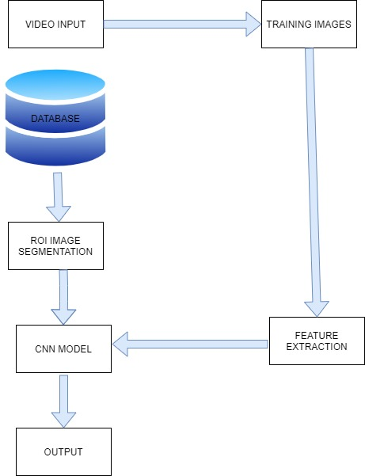
SYSTEM ARCHITECTURE

Slide 11
ARCHITECTURE OF PROPOSED WORK
Input image is splited into frames (f1,f2,f3,f4) and it compare the frames with
trained input and the final object is detected .
These frames are splited with the help of advanced algorithms.
Original Image Detected object
with name
f1
f2
f3
f4

Slide 12
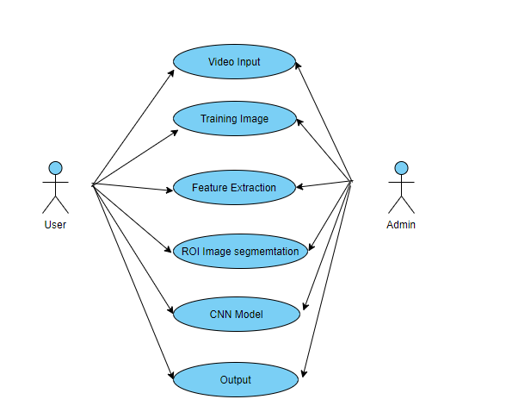
USE CASE DIAGRAM

Slide 13
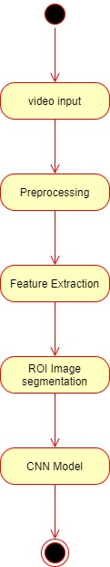
ACTIVITY DIAGRAM

Slide 14
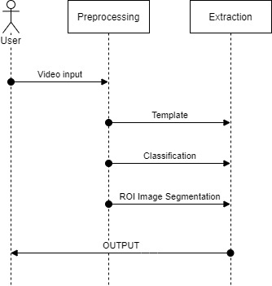
SEQUENCE DIAGRAM

Slide 15
MODULE DESCRIPTION
There are three modules in our project.
The list of modules are as follows:
Object Data collection.
Data Pre processing.
Object Detection.

Slide 16
MODULE 1: OBJECT DATA COLLECTION
Real time data collected from kaggle. Collection of data is one of the major and most important tasks of any machine learning projects. Because the input we feed to the algorithms is data. So, the algorithms efficiency and accuracy depends upon the correctness and quality of data collected. So as the data same will be the output.

Slide 17
MODULE 2: DATA PREPROCESSING
Collecting the data is one task and making that data useful is an-other vital task.
Data collected from various means will be in an unorganized format and there may be lot of null values, in-valid data values and unwanted data.
Cleaning all these data and replacing them with appropriate or approximate data and removing null and missing data and replacing them with some fixed alternate values are the basic steps in pre processing of data.
Even data collected may contain completely garbage values. It may not be in exact format or way that is meant to be. All such cases must be verified and replaced with alternate values to make data meaning meaningful and useful for further processing. Data must be kept in a organized format.

Slide 18
MODULE 3: OBJECT DETECTION
Yolo is an algorithm that uses convolutional neural networks for object detection.
In comparison to recognition algorithms, a detection algorithm does not only predict class labels, but detects locations of objects as well.
The algorithm divides the image into grids and runs the image classification and localization algorithm (discussed under object localization) on each of the grid cells. For example, we have an input image of size 256 × 256. We place a 3 × 3 grid on the image .

Slide 19

SCREENSHOT

Slide 20
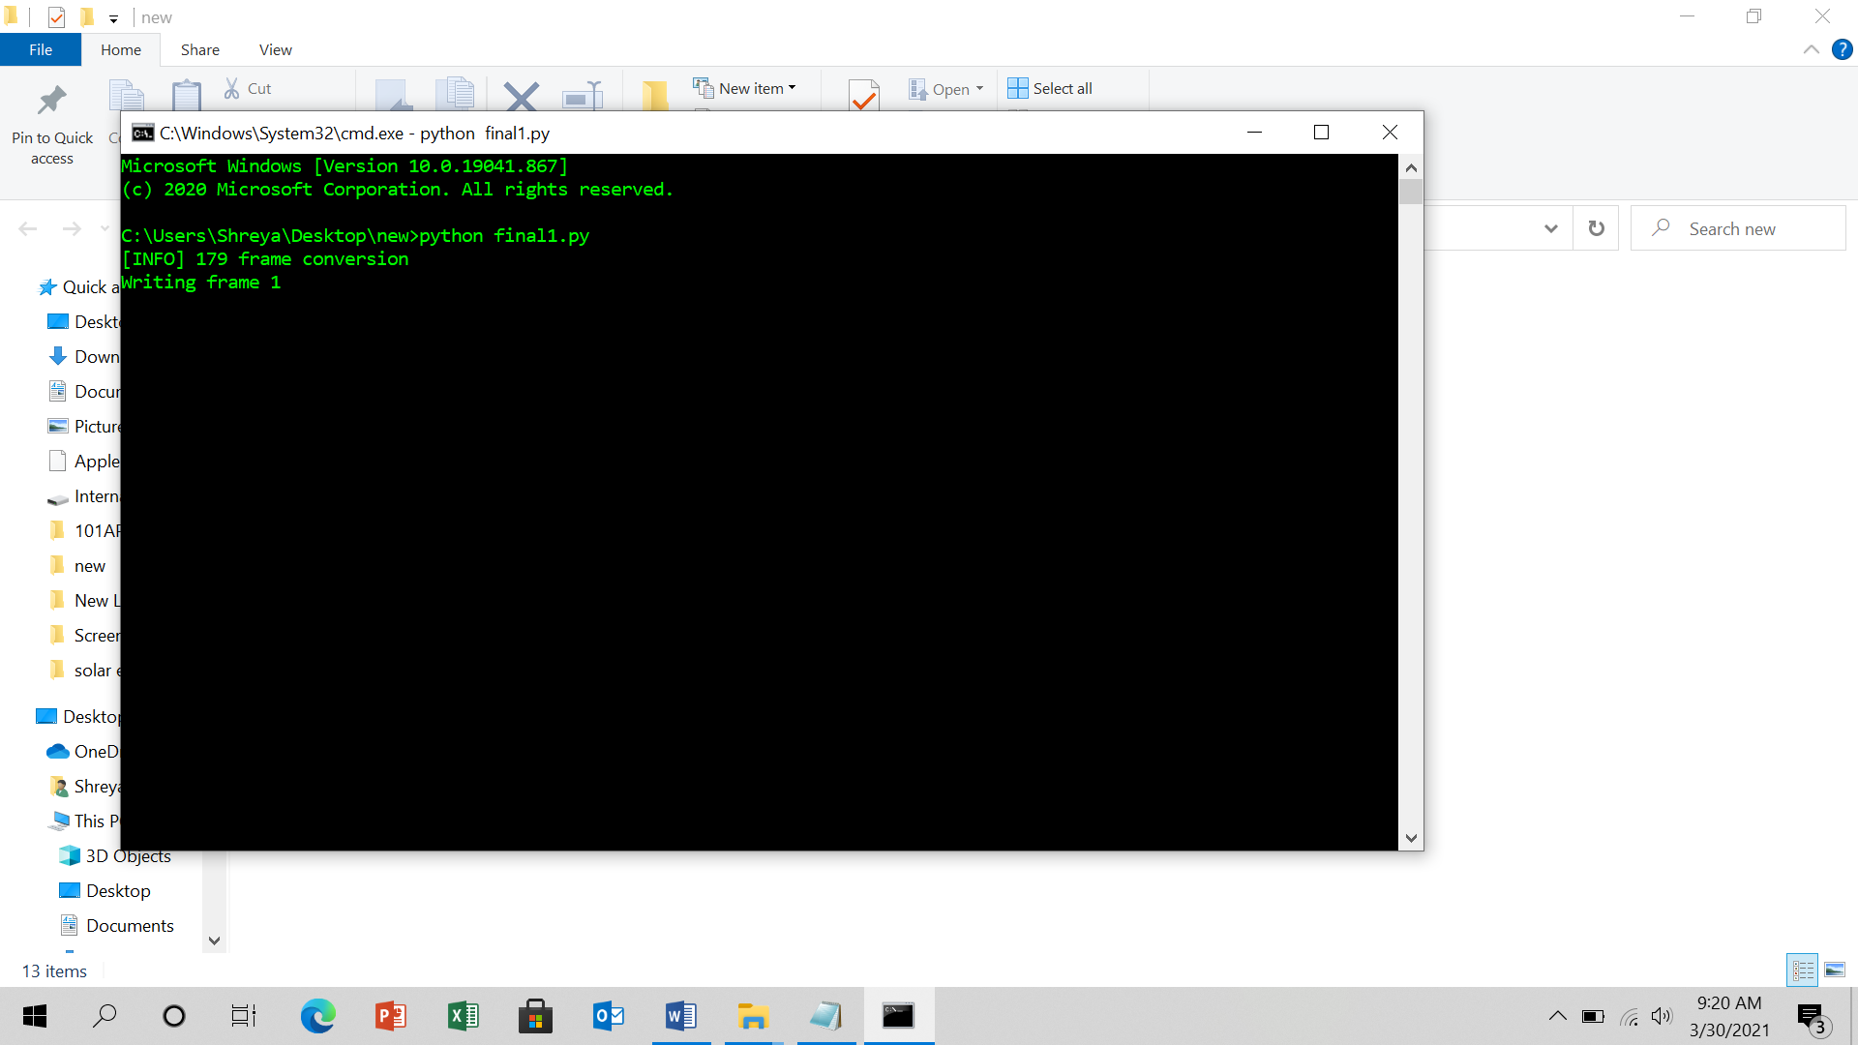
SCREENSHOT

Slide 21
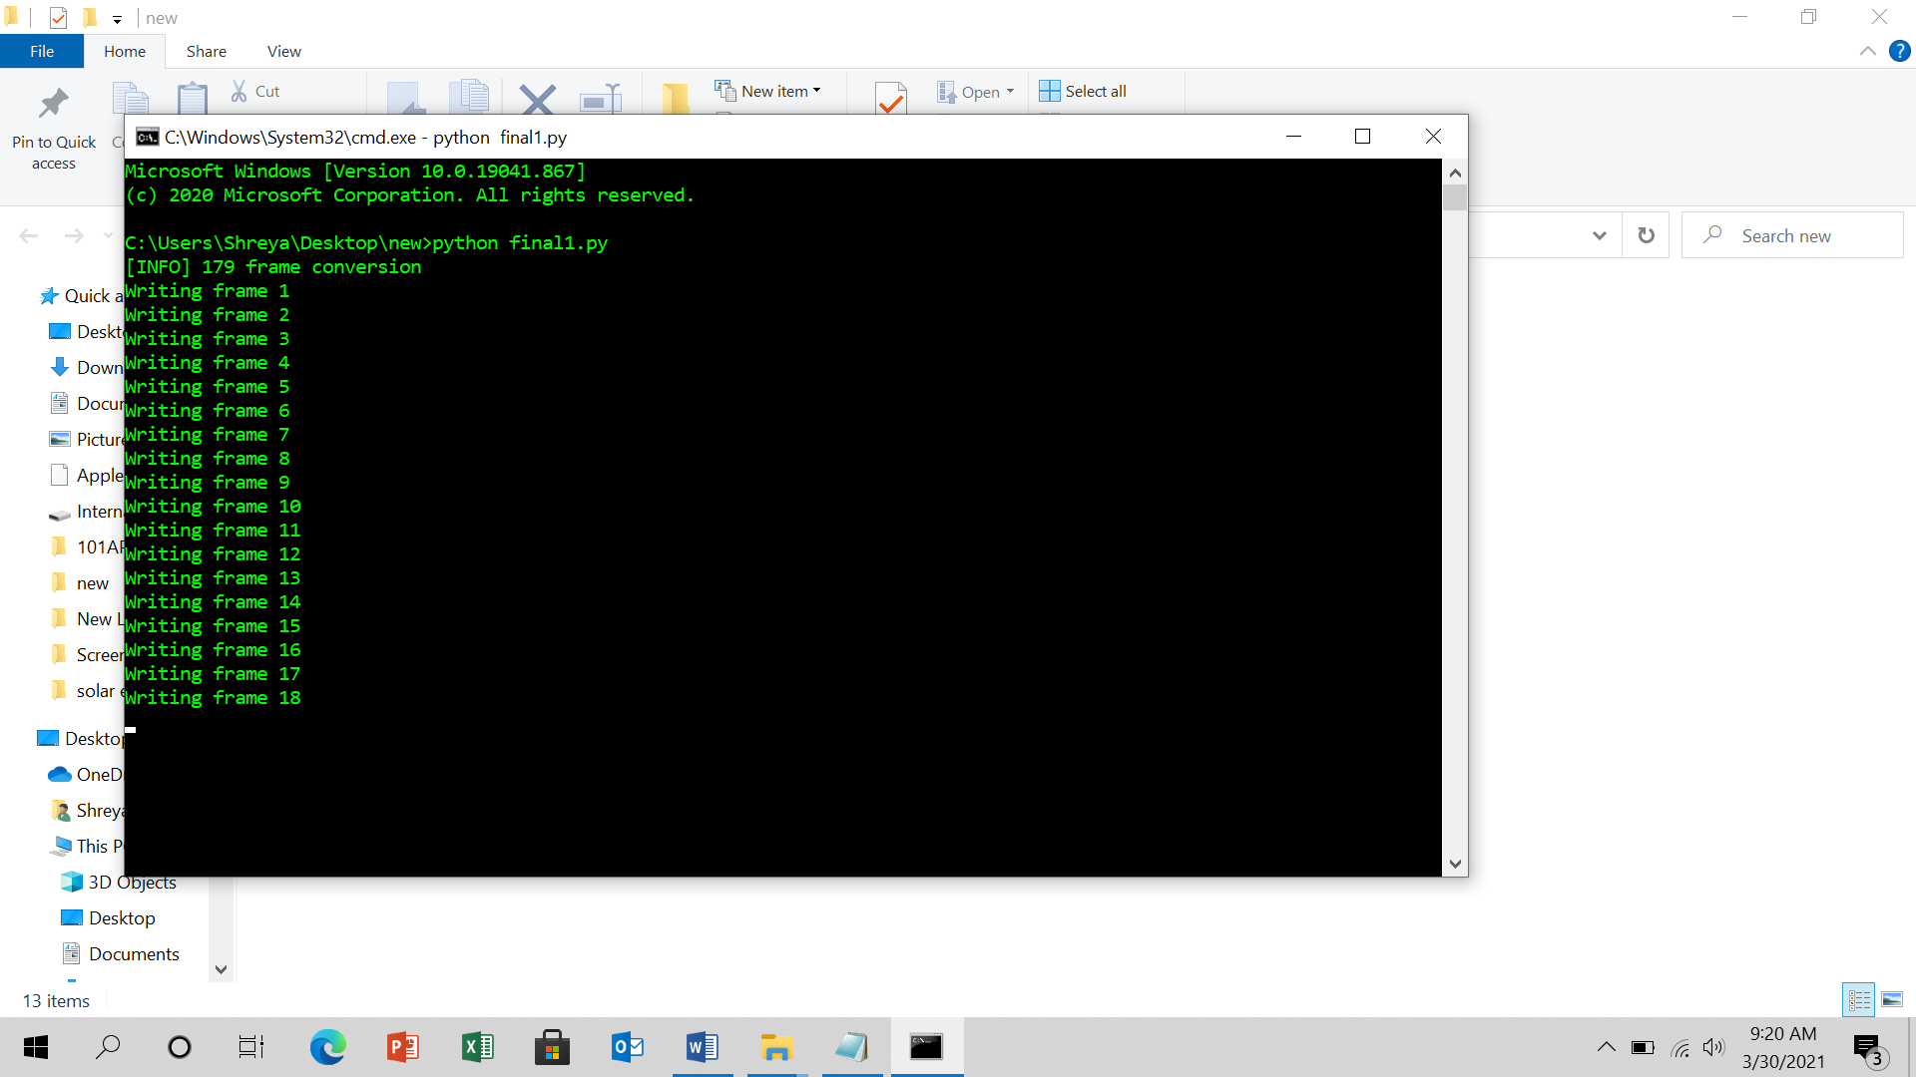
SCREENSHOT

Slide 22
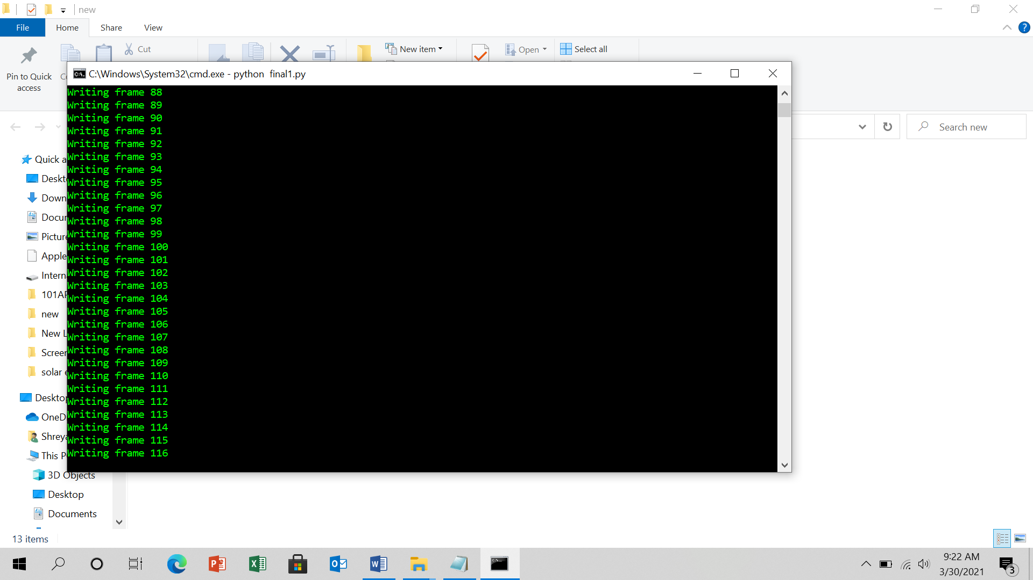
SCREENSHOT

Slide 23
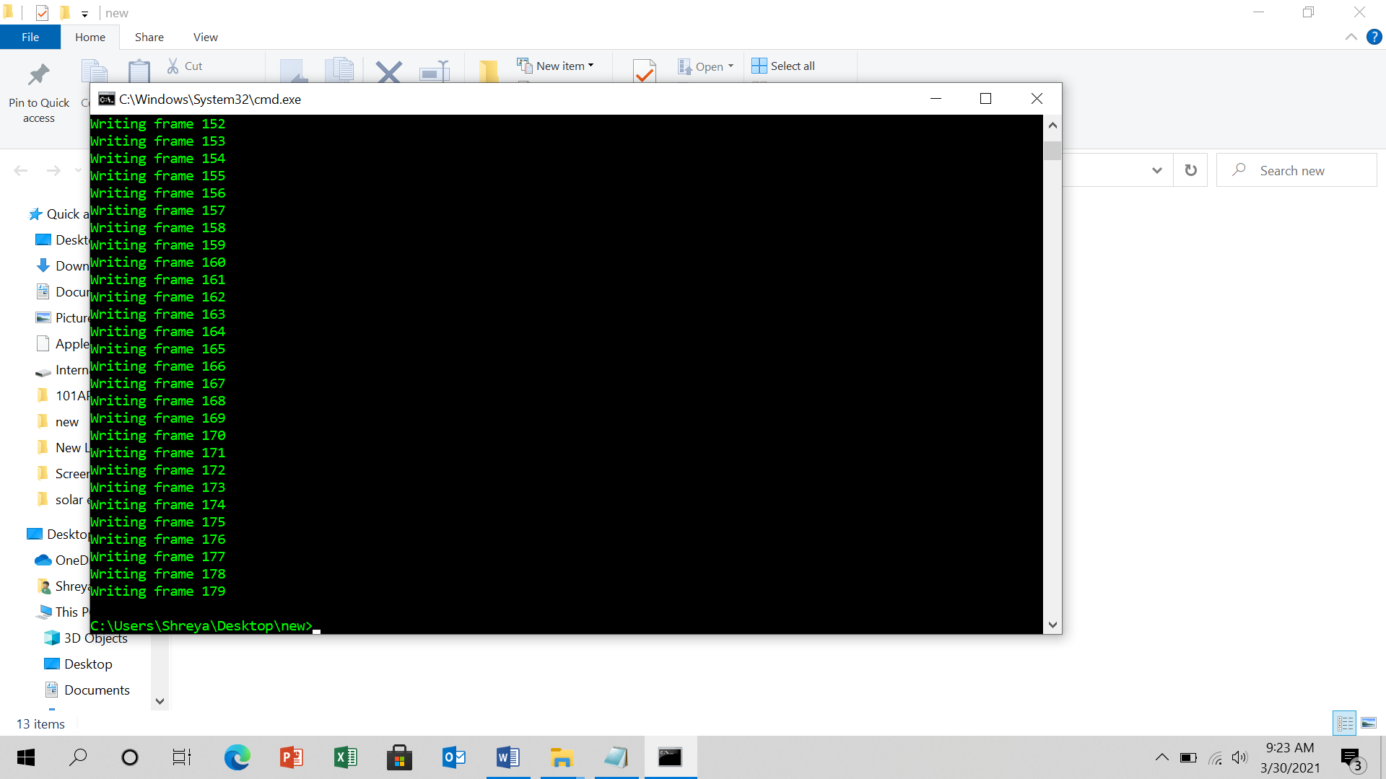
SCREENSHOT

Slide 24
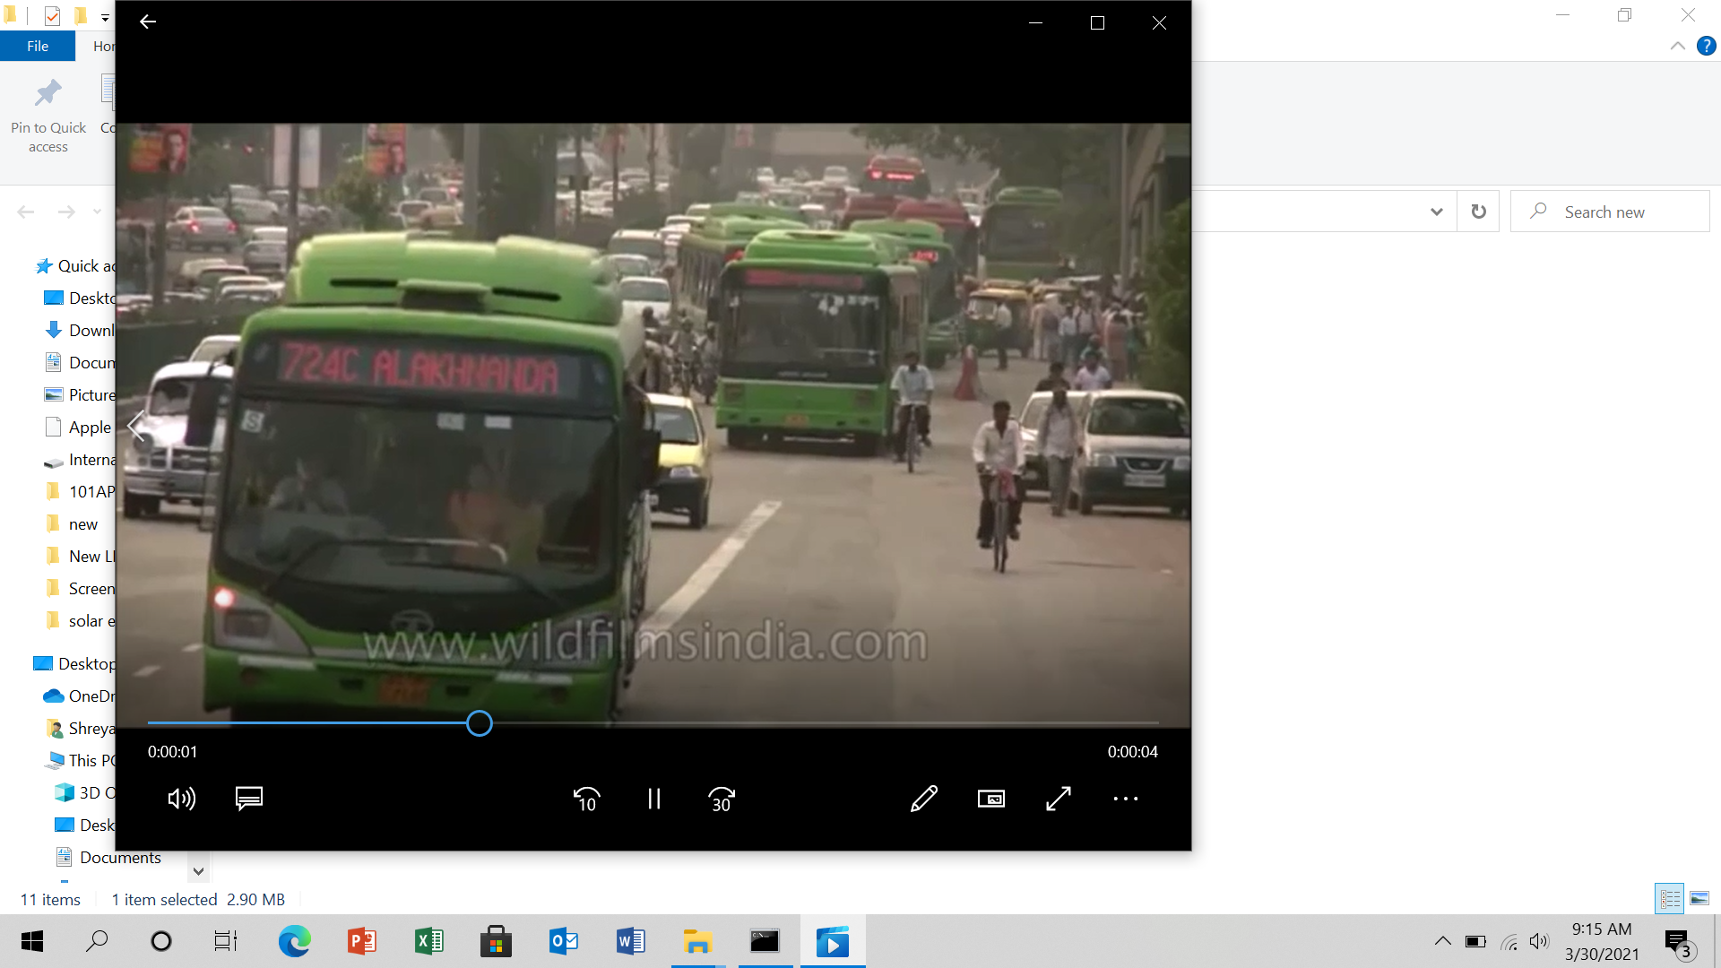
SCREENSHOT

Slide 25
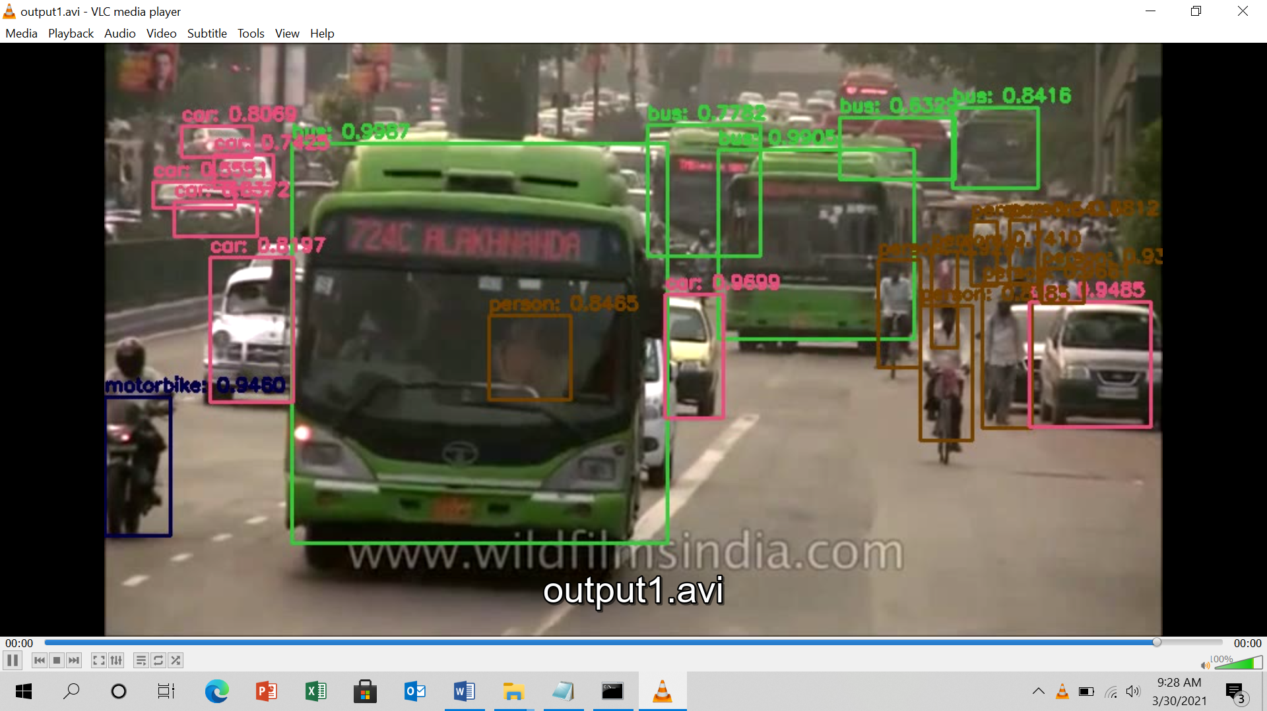
SCREENSHOT

Slide 26
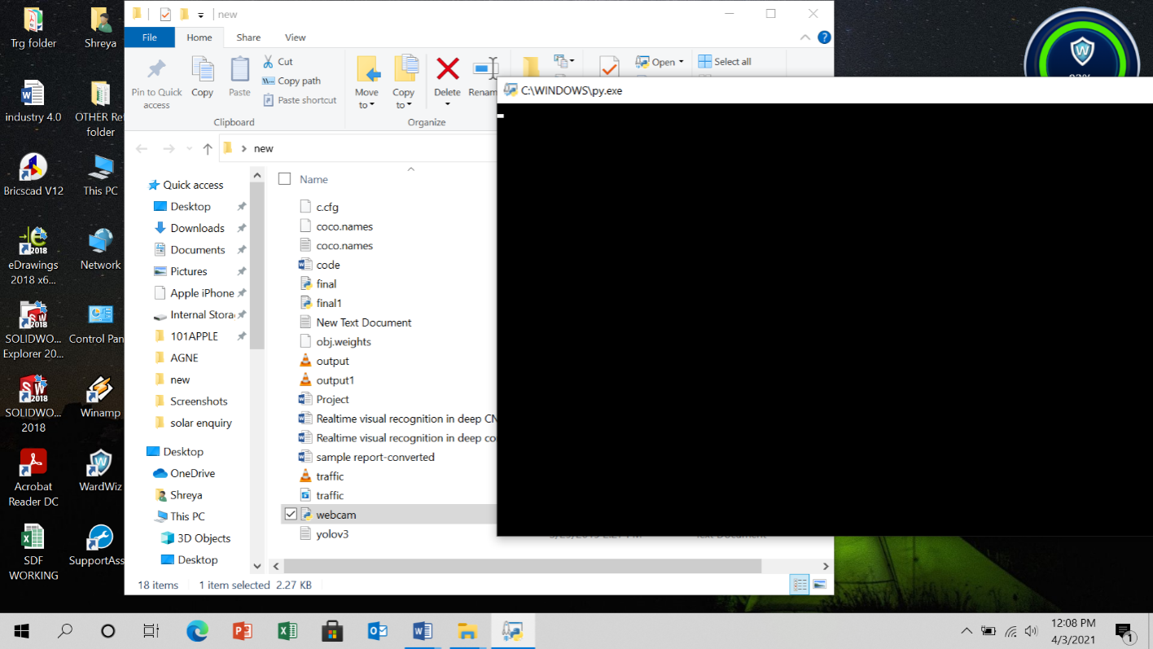
SCREENSHOT

Slide 27
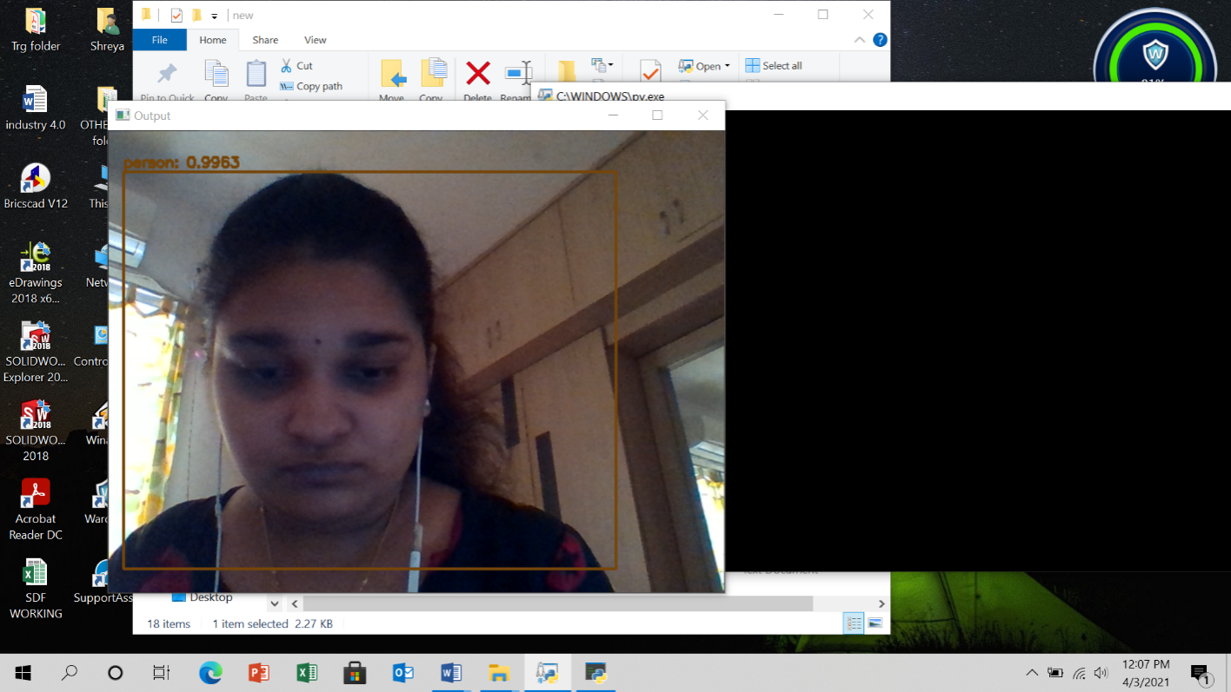
SCREENSHOT

Slide 28
CONCLUSION
Our framework detects all the objects based on training set provided to it. Main view of this project is to increase the accuracy rate of the detection i.e., it recognize the object even in blur stage or under less brightness.
Over 60-65 images can be trained for detection.
This framework can be constructed using deep learning , which is a subset of machine learning in AI that has network capability of learning unsupervised from data that is unstructured or unable.

Slide 29
REFERENCES
1. P. F. Felzenszwalb, R. B. Girshick, D. McAllester, and D. Ramanan, “Object detection with discriminatively trained part-based models,” IEEE Trans. Pattern Anal. Mach. Intell., vol. 32, no. 9, pp. 1627 1645, Sep. 2010.
2. B. Leibe, A. Leonardis, and B. Schiele, “Robust object detection with interleaved categorization and segmentation,” Int. J. Comput. Vis., vol. 77, nos. 1-3, pp. 259-289, May 2008.
3. J. Zhang, M. Marszalek, S. Lazebnik, and C. Schmid, “Local features and kernels for classi cation of texture and object categories: A comprehensive study,” in Proc. Conf. Comput. Vis. Pattern Recognit.Workshop (CVPRW), Jun. 2006, p. 13.
4. P. Viola and M. Jones, “Rapid object detection using a boosted cascade of simple features,” in Proc. IEEE Comput. Soc. Conf. Comput. Vis. Pattern Recognit. (CVPR), vol. 1. Dec. 2001, pp. 511-518.
5. M. Weber, M. Welling, and P. Perona, “Towards automatic discovery of object categories,” in Proc. IEEE Conf. Comput. Vis. Pattern Recognit., vol. 2. Jun. 2000, pp. 101-108.

Slide 30
6. A. Ayvaci and S. Soatto, “Detachable object detection: Segmentation and depth ordering from short-baseline video,” IEEE Trans. Pattern Anal. Mach. Intell., vol. 34, no. 10, pp. 1942 1951, Oct. 2012.
7. D. Liu, M.-L. Shyu, Q. Zhu, and S.-C. Chen, “Moving object detection under object occlusion situations in video sequences,'' in Proc. IEEE Int. Symp. Multimedia (ISM), Dec. 2011, pp. 271-278.
8. J. Kim, G. Ye, and D. Kim, ``Moving object detection under free-moving camera,'' in Proc. 17th IEEE Int. Conf. Image Process. (ICIP), Sep. 2010, pp. 4669-4672.
9.B. Qi, M. Ghazal, and A. Amer, ``Robust global motion estimation oriented to video object segmentation,'' IEEE Trans. Image Process., vol. 17, no. 6, pp. 958 967, Jun. 2008.
10. S. Kumar and M. Hebert, ``A hierarchical eld framework for unified context-based classi cation,'' in Proc. 10th IEEE Int. Conf. Comput. Vis. (ICCV), vol. 2. Oct. 2005, pp. 1284-1291.

Slide 31
THANK YOU

